Slide 1
Start Up Council Meetups
A series of engagements across New Zealand for the StartUp Advisors Council to hear directly from the StartUp Ecosystem
Auckland (VCs session) | 1 Sep
Tauranga | 5 Sep
Wellington | 13 Sep
Christchurch | 15 Sep
Queenstown | 27 Sep
Dunedin | 28 Sep
Auckland | 13 Oct
Hamilton | 18 Oct
Online | 18 Oct
Māori | 25 Oct
International/Australia online session | TBC
Enquiries or feedback to startupcouncil@mbie.govt.nz

Slide 2
AGENDA
StartUp Advisors Council – who/what/when? 5-10 mins
Ecosystem strategy and vision 10-15 mins
Issues and Solutions 35 mins
Prioritisation and Refinement 30 mins

Slide 3
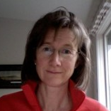
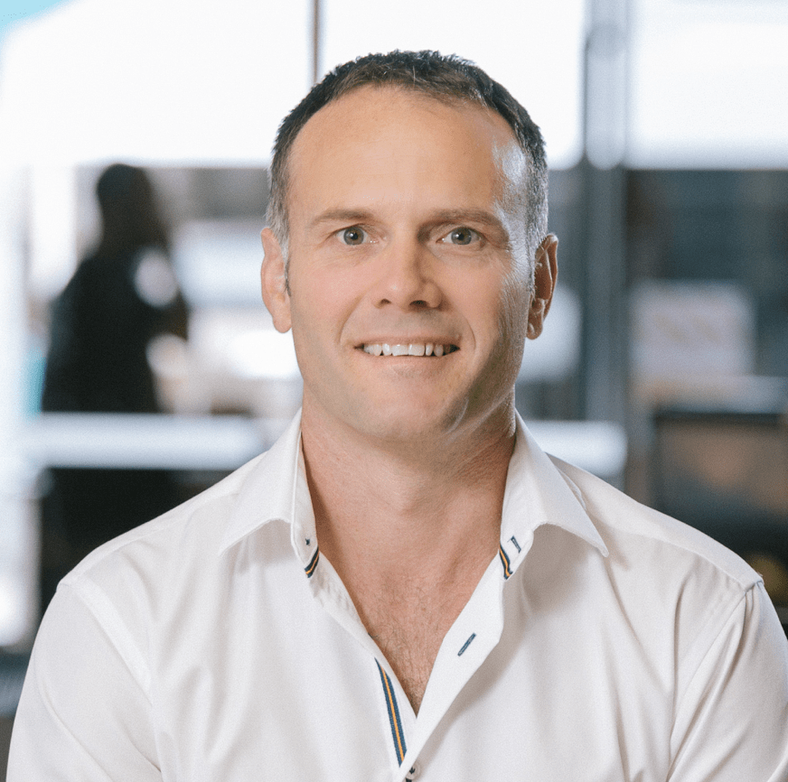
Startup Advisors Council: who, what, when?
Established to help identify and address the opportunities and challenges facing high growth startup businesses.
The Council is seeking to identify the greater barriers to building high-growth startups and unlock solutions.
The members of the Council are:
Phil McCaw, Managing Partner of Movac
Suse Reynolds, Chair of the Angel Association New Zealand
Marian Johnson, Chief Executive of Ministry of Awesome
Grant Straker (Ngāti Raukawa), co-founder of the A.I. language translation platform Straker Translations
Mike Carden, start-up founder (including Sonar6 and Joyous)
Imche Fourie, co-founder and Chief Executive of Auckland-based Outset Ventures
Carl Jones, Managing Partner of WNT Ventures

Slide 4
The Council has been appointed for a 12-month period and asked to report back to Ministers in early 2023…
Ministry of Business, Innovation and Employment (MBIE) officials are supporting the Council on behalf of Hon Stuart Nash (Economic and Regional Development Minister) and Hon Dr Ayesha Verrall (Research, Science and Innovation Minister).
September – October
• Engagement with the startup ecosystem
• Ecosystem benchmarking / appraisal (Startup Genome)
November – December
• Consider feedback and analysis
• Develop key findings and recommendations
Early 2023
• Council report draft findings and recommendations back to Ministers
• Council broaden conversation to a wider set of stakeholders
Mid-2023
• Council formally report back to Government with findings and recommendations.
2023 onwards
• Council output continues to guide behaviours and collaboration in the ecosystem and influence the policy choices of government
Gathering evidence
Synthesising evidence base and prioritisation
Communicating findings and achieving influence
Notes:
o From June-December 2022, the Council will work to gather evidence and identify key issues facing the ecosystem. This will involve posing key questions and presenting its strategy, including vision statement, in a series of regional stakeholder engagements over September and October. By the end of the year the Council will have formed a longlist of priorities and potential actions they believe are required to achieve the vision.
o In Q1 2023, the Council will work to write up its draft findings, priorities, actions and recommendations, and seek feedback from stakeholders.
o In Q2 2023, the Council will finalise and present its findings.
Startup Genome work:
Benchmarking – establishing how the NZ startup eco system compares globally, including a structured survey of founders
Policy levers – identification of the big levers that are in play in other eco-systems, and how our settings compare

Slide 5
A vision and a strategy for the StartUp Ecosystem
DRAFT MATERIAL - FOR DISCUSSION
FEEDBACK REQUESTED:
These slides present the Startup Council’s current thinking on “what we’re trying to achieve”
We are not intending group discussion on this today - our focus for these sessions is on sourcing and refining solutions to the “burning issues” we see in the sector
However…
The Council do welcome feedback on the overall strategy and vision, and on particular language or metrics used.
Provide your thoughts directly onto the print-outs today, or email: startupcouncil@mbie.govt.nz

Slide 6
A vision for the startup ecosystem
In the next ten years we transform the New Zealand economy to be a world leader in sustainable value creation and innovation grounded in empathy for people and the planet
Notes:
If you can’t measure it, you’ll always meet it … we measure our achievement of this vision via our Startup Genome ranking … we achieve a top 5 ranking in Start Genome’s emerging ecosystems

Slide 7
Defining a startup
they are not SMEs !! 😣
Startups are solving the world’s big problems…
super ambitious
high growth
disruptive
new
generating almost all our net new job growth
creating massive impact and value
Notes:
super ambitious - led by super charged founders and teams
high growth - growing customers, revenue and value quickly
grounded in tech - in some shape or form but not always eg 42 Below
disruptive - creating new products, services or ways of doing business
new - they are young companies, not more than 15 years old eg Xero is still a startup in some contexts
massive impact and value - social, economic, financial, environmental

Slide 8
Outputs - What we want/could deliver
250,000 future focused, tech industry jobs
5000 active high growth startups
Hubs and ecosystem connectivity - agtech, aerospace, gaming, medtech, fintech…
Every year…
5 startups become $100m revenue companies
3 startups become unicorns
25 startups are spun out of our PROs
Notes:
Things you can measure … services and products

Slide 9
Outcomes - What this could deliver
Big lift in productivity
A carbon neutral economy
Entrepreneurship is part of the kiwi DNA
Equity and diversity across the sector
Improved income equality
A full and sustainable capital pathway for startups
Higher per capita incomes
Aotearoa is a place where talent wants to live
Notes:
Changes we want to see … more , better , enhanced
Show slides 46 (our median series A is small/low) and 48 (our share of big series A rounds is low) in 2018 Genome ppt … ref the gaps we have here

Slide 10
Our purpose and promise
We are building a startup ecosystem so that no matter where you come from it provides you with the best opportunity to succeed and thrive
we all understand what we stand for!
Notes:
NB The Startup Genome finding that kiwis were off the charts when it came to wanting to change the world but chose the smallest TAM - we need to help, support, be laser focused on helping kiwis achieve their ambitions … eg Rocket Lab … imagine if we’d believed in Peter?? Would have got there anyway probably but no doubt would have done it quicker if the above promise had been in place
Swap out “to change the world” FOR “good for New Zealand - good for the world” … we see tomorrow first ??

Slide 11
Issues and solutions
DRAFT MATERIAL - FOR DISCUSSION
FORMAT
Facilitator presents key themes for ecosystem issues and solutions
Group discussion (4-6 people) around issues and solutions
KEY QUESTION
Some issues are well-understood…
…but can we identify impactful and practicable solutions?

Slide 12
High-level themes
CONNECTIVITY
TALENT
CAPITAL

Slide 13
High-level themes
CONNECTIVITY
TALENT
CAPITAL
Cross-cutting questions
Which parts of our ecosystem do you consider to be functioning well? What can we “turbo-charge”?
Where are we weakest, which pillar is the biggest hand-brake on growth for you? Can these issues be addressed, and if we could address them would it make a material difference?

Slide 14
High-level themes
DRAFT MATERIAL - FOR DISCUSSION
CONNECTIVITY
TALENT
CAPITAL
Cross-cutting questions
Which parts of our ecosystem do you consider to be functioning well? What can we “turbo-charge”?
Where are we weakest, which pillar is the biggest hand-brake on growth for you? Can these issues be addressed, and if we could address them would it make a material difference?
How would a highly functioning startup ecosystem connect you to people who can accelerate your business (products, markets, strategy)?
Is there a role for hubs (physical, virtual)? If so…
In which sectors? Who should be in them? (startups, researchers, investors, EDAs, etc)
What’s government’s role in facilitating or enabling hubs?
How would a high functioning startup ecosystem help you find talent? How do we ensure we can scaleup effectively?
How do we balance growing talent locally vs sourcing overseas?
How do you develop yourself? What do we do to develop founder teams? What else should we be doing?
Is the ecosystem sufficiently diverse and inclusive?
How would a highly functioning startup ecosystem help you access capital (equity, debt, grants)?
How do capital markets currently support startups at different stages?
Thematic questions

Slide 15
High-level themes
CONNECTIVITY
TALENT
CAPITAL
Cross-cutting questions
Which parts of our ecosystem do you consider to be functioning well? What can we “turbo-charge”?
Where are we weakest, which pillar is the biggest hand-brake on growth for you? Can these issues be addressed, and if we could address them would it make a material difference?
How would a highly functioning startup ecosystem connect you to people who can accelerate your business (products, markets, strategy)?
Is there a role for hubs (physical, virtual)? If so…
In which sectors? Who should be in them? (startups, researchers, investors, EDAs, etc)
What’s government’s role in facilitating or enabling hubs?
How would a high functioning startup ecosystem help you find talent? How do we ensure we can scaleup effectively?
How do we balance growing talent locally vs sourcing overseas?
How do you develop yourself? What do we do to develop founder teams? What else should we be doing?
Is the ecosystem sufficiently diverse and inclusive?
How would a highly functioning startup ecosystem help you access capital (equity, debt, grants)?
How do capital markets currently support startups at different stages?
Thematic questions
GROUP TASK (30 minutes): Ideation - What solutions are available to address limitations or maximise performance of the ecosystem?

Slide 16
Boiling the ocean: prioritising and refining the ideas raised today
DRAFT MATERIAL - FOR DISCUSSION
FORMAT
Reflecting on the range of issues and solutions already identified, small groups (4-6 people) consider key questions and hone in on 2-3 “game-changing” initiatives or policy changes
These “game-changers” can (should?) be a mixture of things that the ecosystem will own and deliver on (led by private actors) or initiatives that require government (legislation, investment, crown entity activity, etc)

Slide 17
Prioritisation and refinement Most important issues & impactful solutions
KEY QUESTIONS
What are the most impactful actions or behaviours (existing strengths or necessary changes) that private sector or government could focus on?
What are the 2-3 game-changing settings changes (private sector practices or government policy settings)?
What is the most important thing for government and private sector to work together on?
GROUP TASK (20 minutes)
In small groups (4-6 people) consider how you would prioritise the issues raised today.
Pick your 2-3 “game-changers” for the ecosystem from those ideas which have been raised. Refine:
Who bears responsibility for owning the solution (i.e. govt or other), and which other actors are required?
How would you design the solution to ensure that it is as effective as possible: impactful, feasible and timely?
How would you sell the proposed solution to ecosystem participants and/or policy-makers?
Report back to group: if you were on the StartUp Advisors Council, what are the 1 or 2 things that you would want to achieve?

Slide 18
NEXT STEPS
DRAFT MATERIAL - FOR DISCUSSION
Council members undertake further community engagement over 22Q3
Council members meet to discuss feedback from the community at end of Q3 and refine the strategy / vision, key issues and potential solutions
Council members formulate advice to the Government 22Q4 / 23Q1
Council members publish findings and recommendations 23Q2

Slide 19
Appendix Non-essential or edited out content. Kept here for reference.

Slide 20
NB: Draft “sliders” on ecosystem tradeoffs
Views on focussing/balancing effort on ecosystem “choices” / tradeoffs:
Neither
/ Both
Seek benefits of agglomeration and co-locating around “hubs” and/or imitating city-based ecosystems |  | Regionalising activity and/or the idea that NZ’s ecosystem could/should be more decentralised by design
If “hubs” are desirable, then who bears responsibility for creating them? What role could/should govt play?
Promoting and attracting greater diversity within the sector |  | Ecosystem maturity and sophistication
(NB: open question as to whether this is a tension or if there is a win-win outcome available)
Doubling down on strength |  | Ameliorating weakness
Where is the ecosystem relatively “skinny” vs “fat”? (For which firms, in which communities or sectors, at which stage, etc)

Slide 21
We want to put this on steroids
Notes:
Every priority sector represented
Agtech - biolumic
Healthtech - Aroa, imagr,
Carbon neutral and climate change - cogo, mevo, lanzatech, avertana, eithique
Housing - xframe
Productivity - soul machines, ambit
Social equity - sharesies, crimson consulting
Wellbeing - chnnl, groov
Every region
Every ethnicity - maori (Straker, Robotics Plue) pacifika (Astrix Aeronautics) chinese (enring)
Diversity - women (Sharesies, Chnnl, Jobloads, Beany, 1Centre)

Slide 22
What do you think?
Do you have views on the intent in the vision, purpose and promise statements?
Do you have views on the specific language used in the vision, purpose and promise statements?
Are the “outputs” the right goals?
Not intending to have a large group discussion on these questions… but the StartUp Council is keen to receive feedback and refine the pitch.
Please provide any feedback onto the print-outs in the room, to one of the Council members directly, or by emailing through to startupcouncil@mbie.govt.nz

